Slide 1
LEADERSHIP BEHAVIORS AND POSITIVE PSYCHOLOGICAL CAPITAL IN THE WORKPLACE
Janet L. Medlock

Slide 2
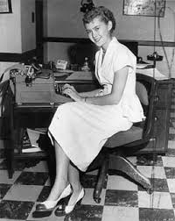
Introduction
My background in a nutshell…
…why this topic is important to me.

Slide 3
Leadership Behaviors
Think about the best supervisor and the best work environment that you can recall.
What were some things that made it a positive experience?
Did you want to “go the extra mile” and, if so, why?

Slide 4
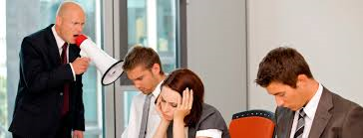
Leadership Behaviors
Conversely, think about the worst supervisor and the worst work environment that you can recall.
What were some things that made it so miserable?
Did you want to “go the extra mile” in this environment?

Slide 5
The Positive Psychology Movement
Psychology has historically been focused on a pathology model—exploring what is wrong with people, not what is right.
Positive Psychologists:
Focus on ways to help people flourish rather than just function (Robison, 2003).
Study the types of experiences that make people feel good, the personal traits that make up happiness and ways to create positive institutions.
Researchers in this field study the types of experiences that make people feel good, the personal traits that make up happiness and ways to create positive institutions.

Slide 6
Fred Luthans, Ph.D, Professor of Management and Social Psychology
One of the first management scholars to apply behavioral science to better understand and effectively manage human behavior in organizations.
Positive Psychological Capital (“PsyCap”)
https://www.youtube.com/watch?v=t_bJ6XdRvnA&index=3&list=PLHY958_V-5QFI2ILIZQcz3Umx_MK_uzKV

Slide 7
The Four Constructs of PsyCap (the “HERO” within)
- HOPE
persevering toward goals and, when necessary, redirecting paths to goals in order to succeed

Slide 8
The Four Constructs of PsyCap (the “HERO” within)
EFFICACY
having confidence (self-efficacy) to take on and put in the necessary effort to succeed at challenging tasks

Slide 9
The Four Constructs of PsyCap (the “HERO” within)
RESILIENCE
when beset by problems and adversity, sustaining and bouncing back and even beyond (resilience) to attain success

Slide 10
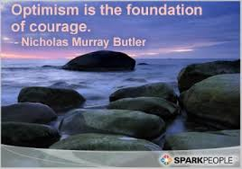
The Four Constructs of PsyCap (the “HERO” within)
OPTIMISM
making a positive reference (optimism) about succeeding now and in the future

Slide 11
The State-Trait Continuum
Personality theorists describe certain characteristics as being:
“Trait-Like”—relatively stable and difficult to change; represents personality factors and strengths; or
“State-Like”—relatively malleable and open to development.
The PsyCap constructs are thought to be more state-like, momentary and open to change.

Slide 12
The PsyCap Questionnaire
A 24-item questionnaire measuring each of the four constructs of PsyCap.
The resulting score represents an individual’s level of PsyCap.
Studies have shown that PsyCap is something that can be taught.

Slide 13
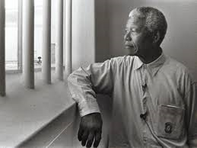
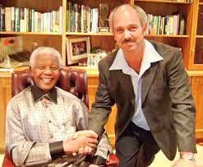
PsyCap in Action…
The Metamorphosis at Robben Island…
http://www.nbcnews.com/video/nightly-news/53760350#53760350
“…[i]t seems that Robben Island morphed from the traditional oppressive prison paradigm to one where the positively oriented prisoners disrupted the institution with a resulting climate of learning and transformation that eventually led to freedom and the end of apartheid….”

Slide 14
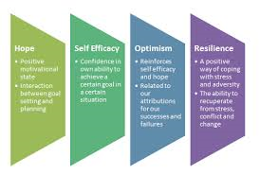
What Can Employees Do to Influence PsyCap in the Workplace?
How can we help to build on these constructs?
Think about the best/worst supervisor you have had and how their behaviors contributed to or detracted from an environment of:
Hope
Self-Efficacy
Resilience
Optimism

Slide 15
Implications for Practice
An environment of hope and inspiration leads to feelings of value and purpose.
“I've learned that people will forget what you said, people will forget what you did, but people will never forget how you made them feel” (Maya Angelou Quote, 2016).

Slide 16
Activity
Larry has not only been missing meetings or arriving late, but he has also appeared to be very tired and disjointed.
Some team members have suggested that Larry’s wife is ill, but others say the situation is rooted with Larry himself. As a leader, what is a good way to handle Larry?

Slide 17
PsyCap in Action
Kennedy Space Center – Orlando, Florida
Everything about the space center embodies hope, self-efficacy, optimism and resilience.
Mission to Mars
Missions/Space Shuttles:
Inspiration, Discovery, Endeavour, Enterprise

Slide 18
PsyCap in Action
Good Leaders are Forward Thinking
Succession planning
It is important to plan for the future, whether it is the future of the organization or the future of the human race.
Astronaut Buzz Aldrin said, “Many say exploration is part of our destiny, but it’s actually our duty to future generations and their quest to ensure the survival of the human species” (Today in Space History, 2016).

Slide 19
Why Does it matter?
The “Silver Tsunami” (Callagan, 2014)
The millennial generation in the workforce Potential Recruitment and Retention Issues

Slide 20
If I’m Not Currently a Leader, How Can I contribute to PsyCap in the Workplace?
DO NOT …
…consistently look for the negative in a situation.
…earn a reputation of being a “pot stirrer,” difficult to deal with and untrustworthy.
…disregard the rules.
DO…
…be part of the solution, not the problem.
…remember to treat others like you wish to be treated.
…understand that you are interviewing every day for the next job to which you would like to be promoted.

Slide 21
Implications for Practice
Leaders can contribute to a positive, creative work environment.
Leaders who are critical and discouraging may hinder an environment of PsyCap and may cause employees to want to leave their jobs.

Slide 22
Leadership and the Future
“…Leadership is evolving due to the changes of the world, such as downturns in economy and technological advances. Organizations must continue to adhere to their values as leadership evolves — considering ethics when promoting or creating leaders, as well as experience and competence.” (Morgan, 2016, para. 3)

Slide 23
In Conclusion…
Studies have shown that employees leave their bosses, not their jobs.
Employee turnover is costly.
Leadership behaviors play a big part in shaping PsyCap in the workplace, for better or for worse.
Working for the Federal Judiciary is an honor and a privilege. As Judiciary employees, we are its best advertisement!

Slide 24
Questions?
Thank you very much for your kind attention!

Slide 25
References
Angelou, M. (2016). Maya Angelou quotes. Brainy quotes. Retrieved from
http://www.brainyquote.com/quotes/authors/m/maya_angelou.html
Brokaw, T. (2013, December 6). Mandela’s unlikely friendship with prison guard [Video file]. Retrieved from http://www.nbcnews.com/video/nightly-news/53760350#53760350
Callagan, P. (2014, October 30). How the impending waver of worker retirements will change government in Minnesota. The Minnesota Post. Retrieved from
http://www.minnpost.com/politics-policy/2014/10/how-impending-wave-worker
retirements-will-change-government-minnesota
Cascio, W.F. & Luthans F. (2013, December 1). Reflections on the metamorphosis at
Robben Island: The role of institutional work and positive psychological capital. Management Department Faculty Publications, paper 107.

Slide 26
References
Robison, J. (2003). The power of positive psychology. The Gallup Business Journal. Retrieved from http://www.gallup.com/businessjournal/1177/power-positive-psychology.aspx
Morgan, J. (2016). What does leadership look like in the future of work? Forbes.com. Retrieved from http://www.forbes.com/sites/jacobmorgan/2016/03/28/what-does-leadership-look-like-in-the-future-of-work/#64b675b72eac
Strauss, D. (2013, June 6). Interview with Professor Fred Luthans. Retrieved from
https://www.youtube.com/watch?v=t_bJ6XdRvnA&index=3&list=PLHY958_V-5QFI2ILIZQcz3Umx_MK_uzKV

Slide 27
References
Today in Space History (2016). Retrieved May 6, 2016, from
https://todayinspacehistory.wordpress.com/great-quotes/

